Slide 1

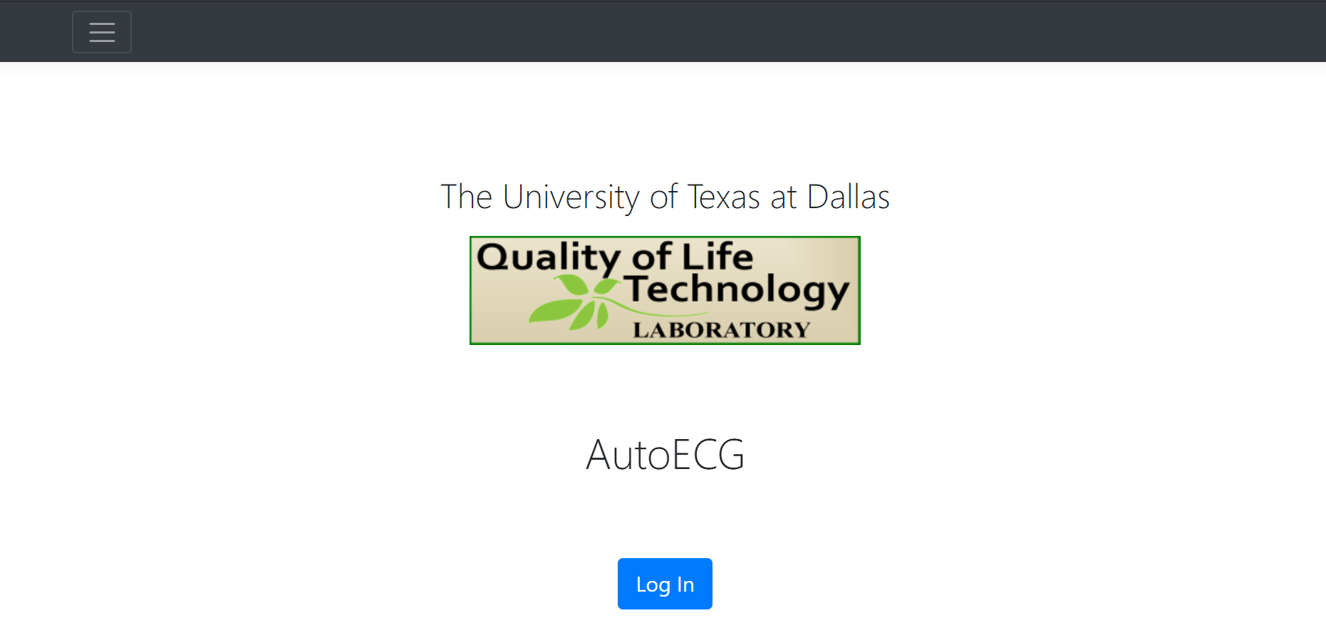
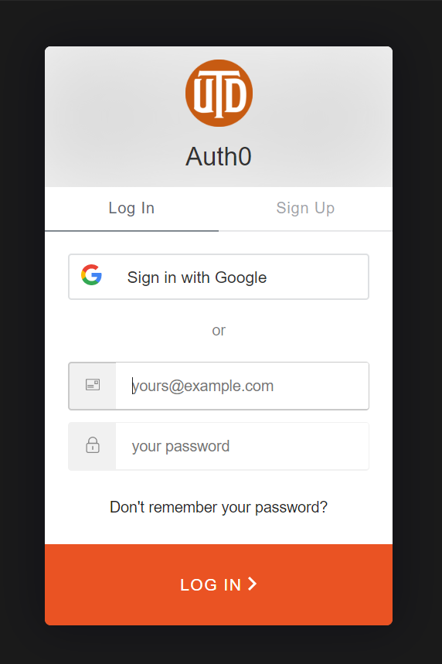
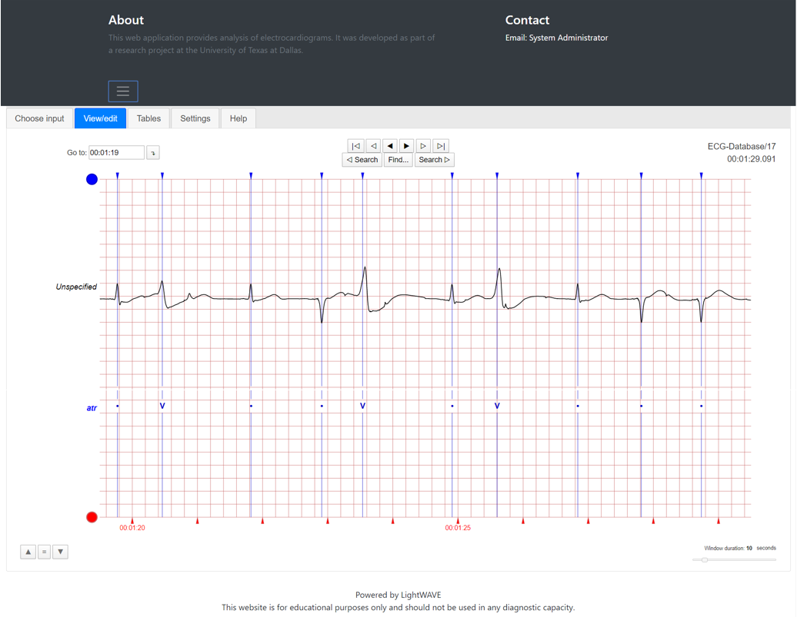

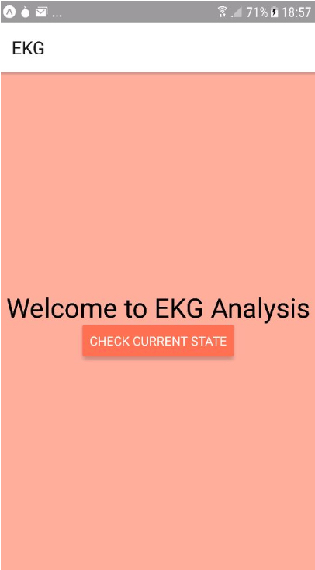
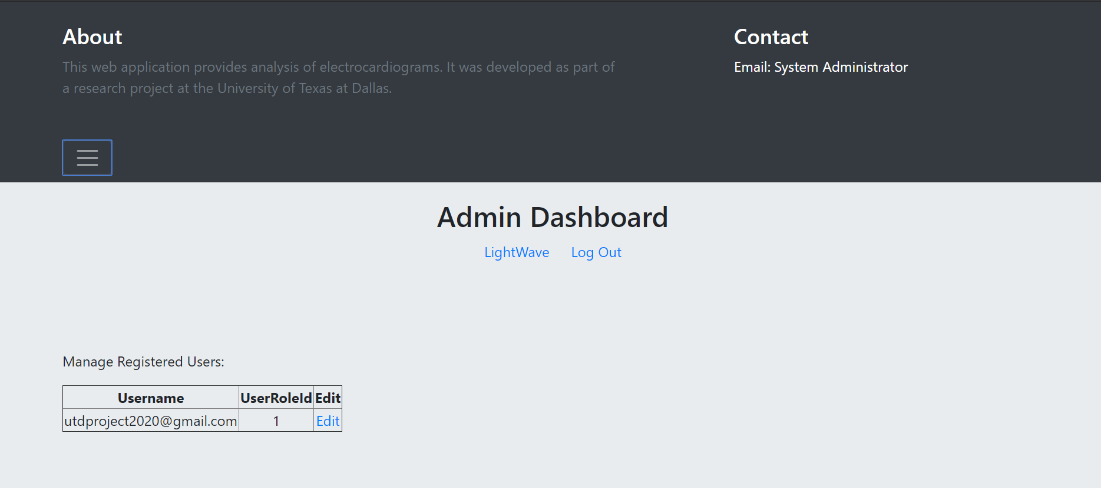
Personalized app utilizing ECG sensor to monitor arrythmia
Jace Baker: michael.baker2@utdallas.edu, Gabriel Balanov: gabriel.balanov@utdallas.edu,
Danielle Faris: danielle.faris@utdallas.edu, Lirit Fuksman: lirit.fuksman@utdallas.edu,
Evelyn Wong: evelyn.wong@utdallas.edu
CS 4485 / Spring 2020
Department of Computer Science
Erik Jonsson School of Engineering & Computer Science
The University of Texas at Dallas
Richardson, TX 75080, USA
Abstract
Results
Arrhythmia is a common heart problem that describes an episodic irregular heartbeat. Our project was created to provide an interface that enables to use lightweight ECG device that can continuously monitor the heart activity. The signals from the ECG are processed through a machine learning model that uses a patented algorithm to classify the signal as normal or abnormal. A cross-platform app was developed in React Native to send notifications to the patient in case of abnormal heartbeat. Additionally, the ECG signals of each patient were annotated and stored in SQL server databases. A website was written in Python to allow for admin, patient and doctor access as well as visualization tool was written in Python to display the annotated signal.
Keywords: Mobile App, ECG signal, Web development
Front page of the website
Website authentication screen
Architecture
Website application
The website application is written in Python 3.6.8 with Flask framework. In order to view the visualized signal, authentication is required and is done via Auth0 API. The patient and doctor end-users are navigated to LightWave page while the administrator is redirected to admin dashboard where he can manage users. Any changes are saved to the database.
LightWave visualization
LightWave visualization is written in Python 3.6.8 and displays the annotated ECG signal which is fetched from the database. The input to the LighWave is the output from machine learning algorithm.
Cross-platform mobile application
The mobile application is available on both Android and iOS and developed in React Native. The input to the application is the ECG signal coming from the heart and the output is sent to the machine learning algorithm in the cloud.
SQL Server Database
SQL server database provides for storage of users and their associated user roles and descriptions of user roles and for storage of annotated ECG records. Each record has an associated user and time stamp. Both the web authentication and LightWave communicate with the database.
Visualized ECG signal on the website
Admin dashboard on the website
App home screen
Impact
Summary
Patients can receive real-time notification of abnormal heart activity
Patients can view ECG signals annotated by machine learning algorithm
Doctors can access all ECG signals of all the patients in a single place and correct any mistakes made by the algorithm
Administrator can quickly change user permissions
Cross-platform mobile app allows for quickly alerting the patient in case of abnormal heartbeat and can be easily changed to accept a broad range in input signal formats
In case of a mistake made by classification machine learning algorithm, doctor can log into the website, access the ECG record and alter the desired beat annotation
LightWave visualization allows for both patient and doctor to view ECG signal records, thus streamlining the process of viewing patient records in a timely manner
Auth0 authentication and Lightwave visualization are based on open source code and hence are free to use
Using Auth0 third-party server instead of locally storing passwords allows for increased security
Performance
The website was developed in alignment with existing frontend design.
No passwords are handled by the application or saved into database. Instead, Auth0 server handles all sensitive password information.
The visualization tool correctly labels the beats in accordance with the machine learning output.
The user is restricted to view only those records which are associated with his username in the database.

